Slide 1
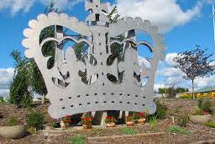
Welcome to Coronation!
https://www.coronation.ca/

Slide 2
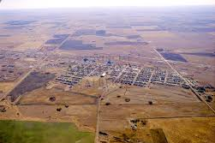
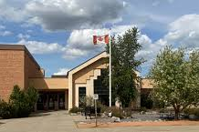
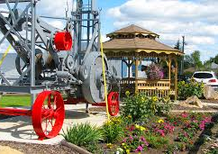
Location
County of Paintearth
262 km (2 hrs 53 mins) east of Edmonton
130 km (1.5 hr) from Wainwright

Slide 3
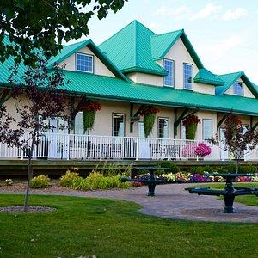
Town of Coronation
Population: 940 (2022)
Economic Base:
Agriculture/Farming
Oil patch
Ranching
Town hosts a rodeo every June that features a parade & pancake breakfast and includes calf roping, barrel racing, bull riding and chuckwagon events.

Slide 4
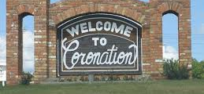
Coronation

Slide 5
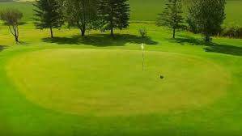
Bowling
Curling
Coronation Golf Course
Skating Arena
Spray park
Ball diamonds
Swimming Pool
Walking Paths
Recreation

Slide 6
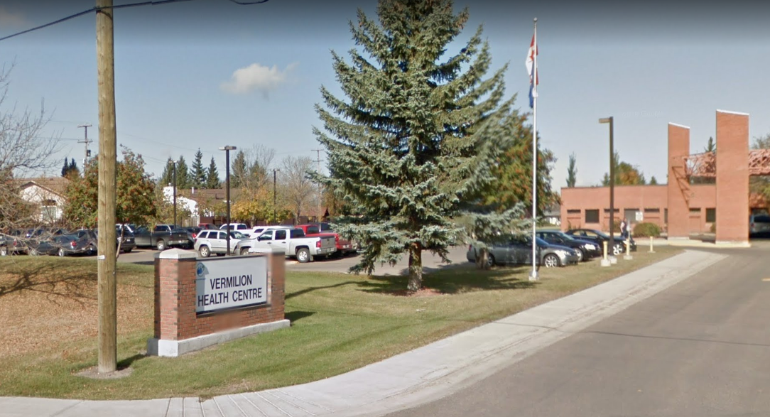
Coronation Hospital and Care Centre
5000 Municipal Rd
Coronation, AB
T0C 1C0
403-578-3803
24-Hour Emergency Services
Cardiac Monitoring
Addiction Counselling
Mental Health Therapy
General radiography (X-ray)
Laboratory
OT, PT, Respiratory, Speech & Therapy
Palliative Care
Pharmacy

Slide 7
Coronation Medical Clinic
5000 Municipal Rd
Coronation, AB
Located on left side of Hospital
1 clinic in this community
teaching clinic
2 Physicians in this practice

