Slide 1
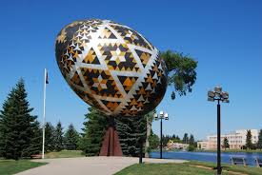
Welcome to Vegreville!
https://www.vegreville.com/

Slide 2
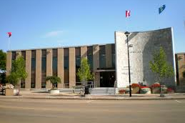
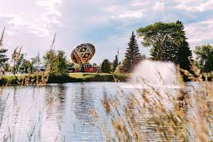
Location
103 km (1 hr 10 mins) east of Edmonton
59.3 km (41 mins ) from Lamont

Slide 3
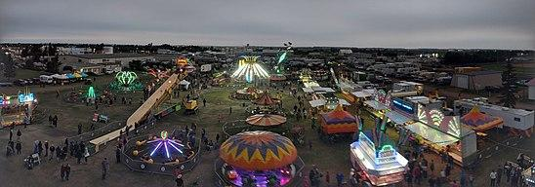
Town of Vegreville
Population: 5708
Economic Base:
Agriculture
Energy
Oil patch
Town hosts a country fair in August every year. Dair starts on main street, which displays antique vehicles, farm equipment, horses, wagon and parade floats.
Vegreville is a Ukrainian Village.

Slide 4
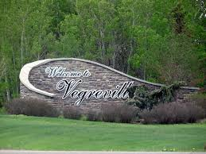
Vegreville

Slide 5
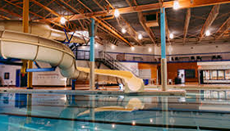
Large egg (Pysanka)
Aquatic fitness centre
Community Gardens
Spray park
Kinsmen golf course
Walking Paths
Recreation

Slide 6
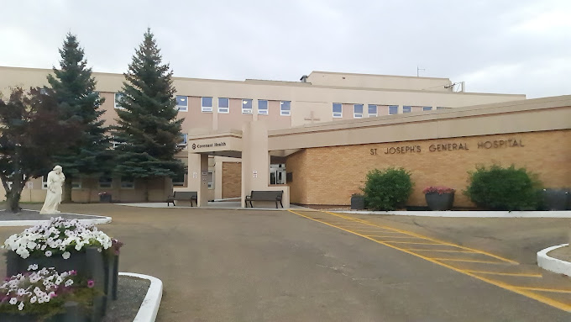
St. Joseph’s General Hospital
5241 43 Street
Vegreville, AB
T(C 1R5
403-632-2811
24-Hour active emergency
Cardiac monitoring
Mental Health
Hemodialysis
General radiography
Laboratory
OT, PT, respiratory therapist
Palliative Care
Surgery: general
Foot Care

Slide 7
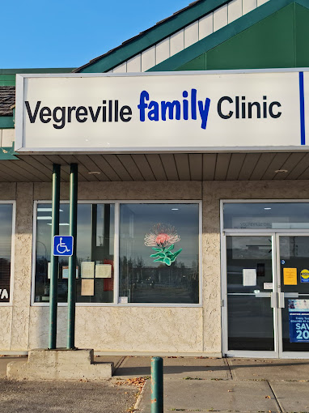
Coronation Medical Clinic
4917 50 Avenue
Vegreville, AB
780-632-6414
3 Physicians in this practice

Slide 8
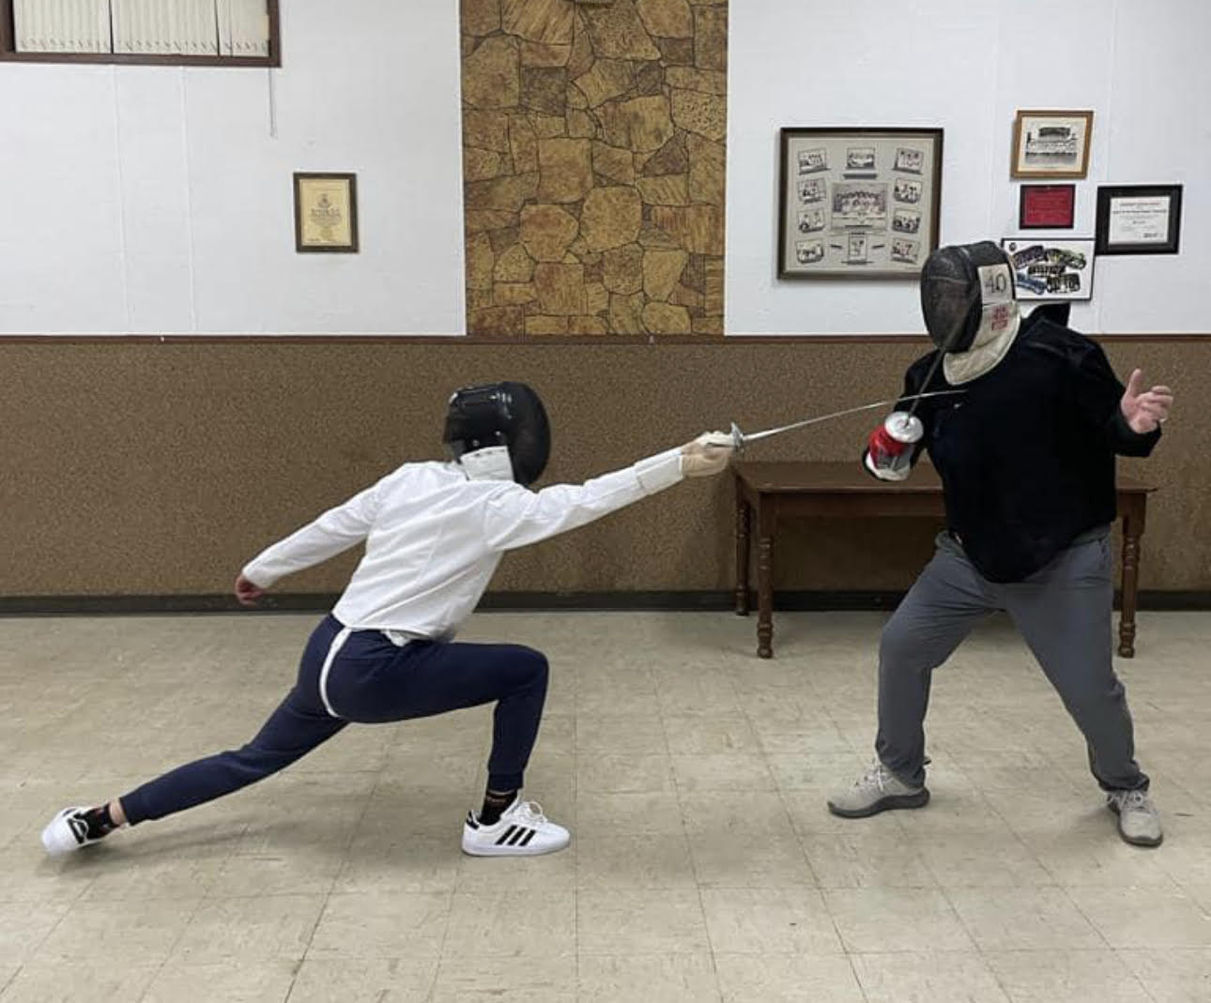
Fencing is a european combat sport that features sword fighting. The three disciplines of modern fencing are the foil, epee and sabre.
Dr. Beren Hollins coaching fencing.

