Slide 1
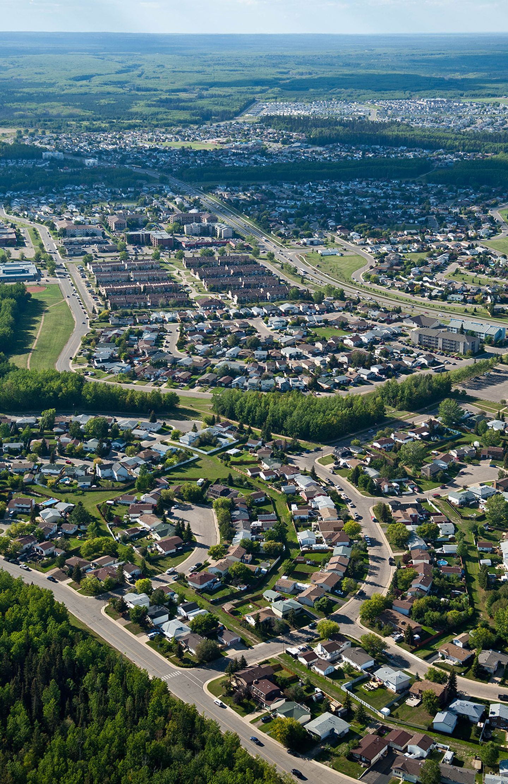
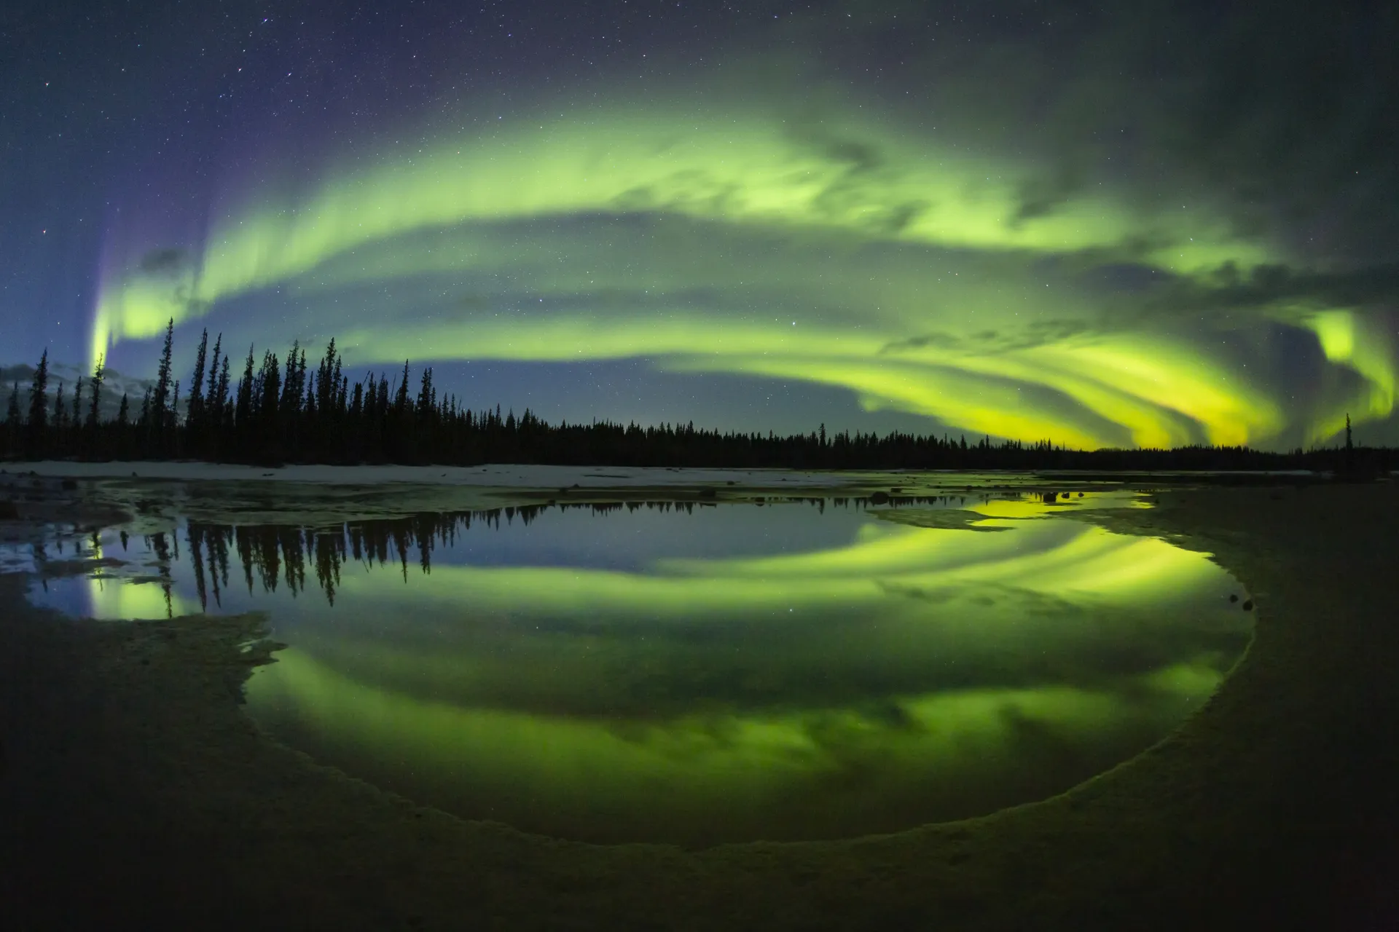
Welcome to
Fort McMurray

Slide 2
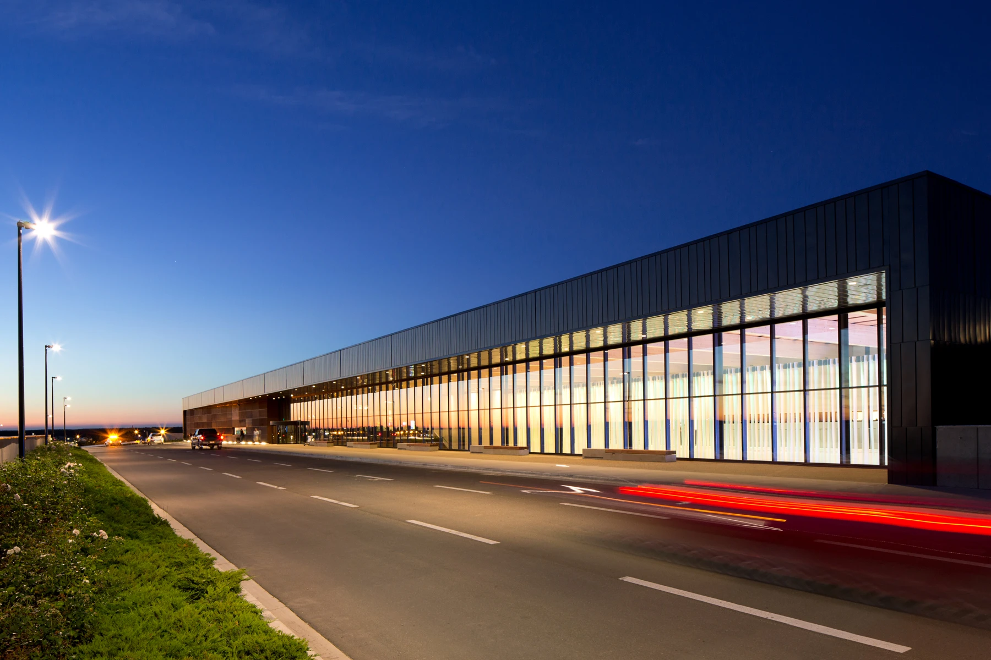
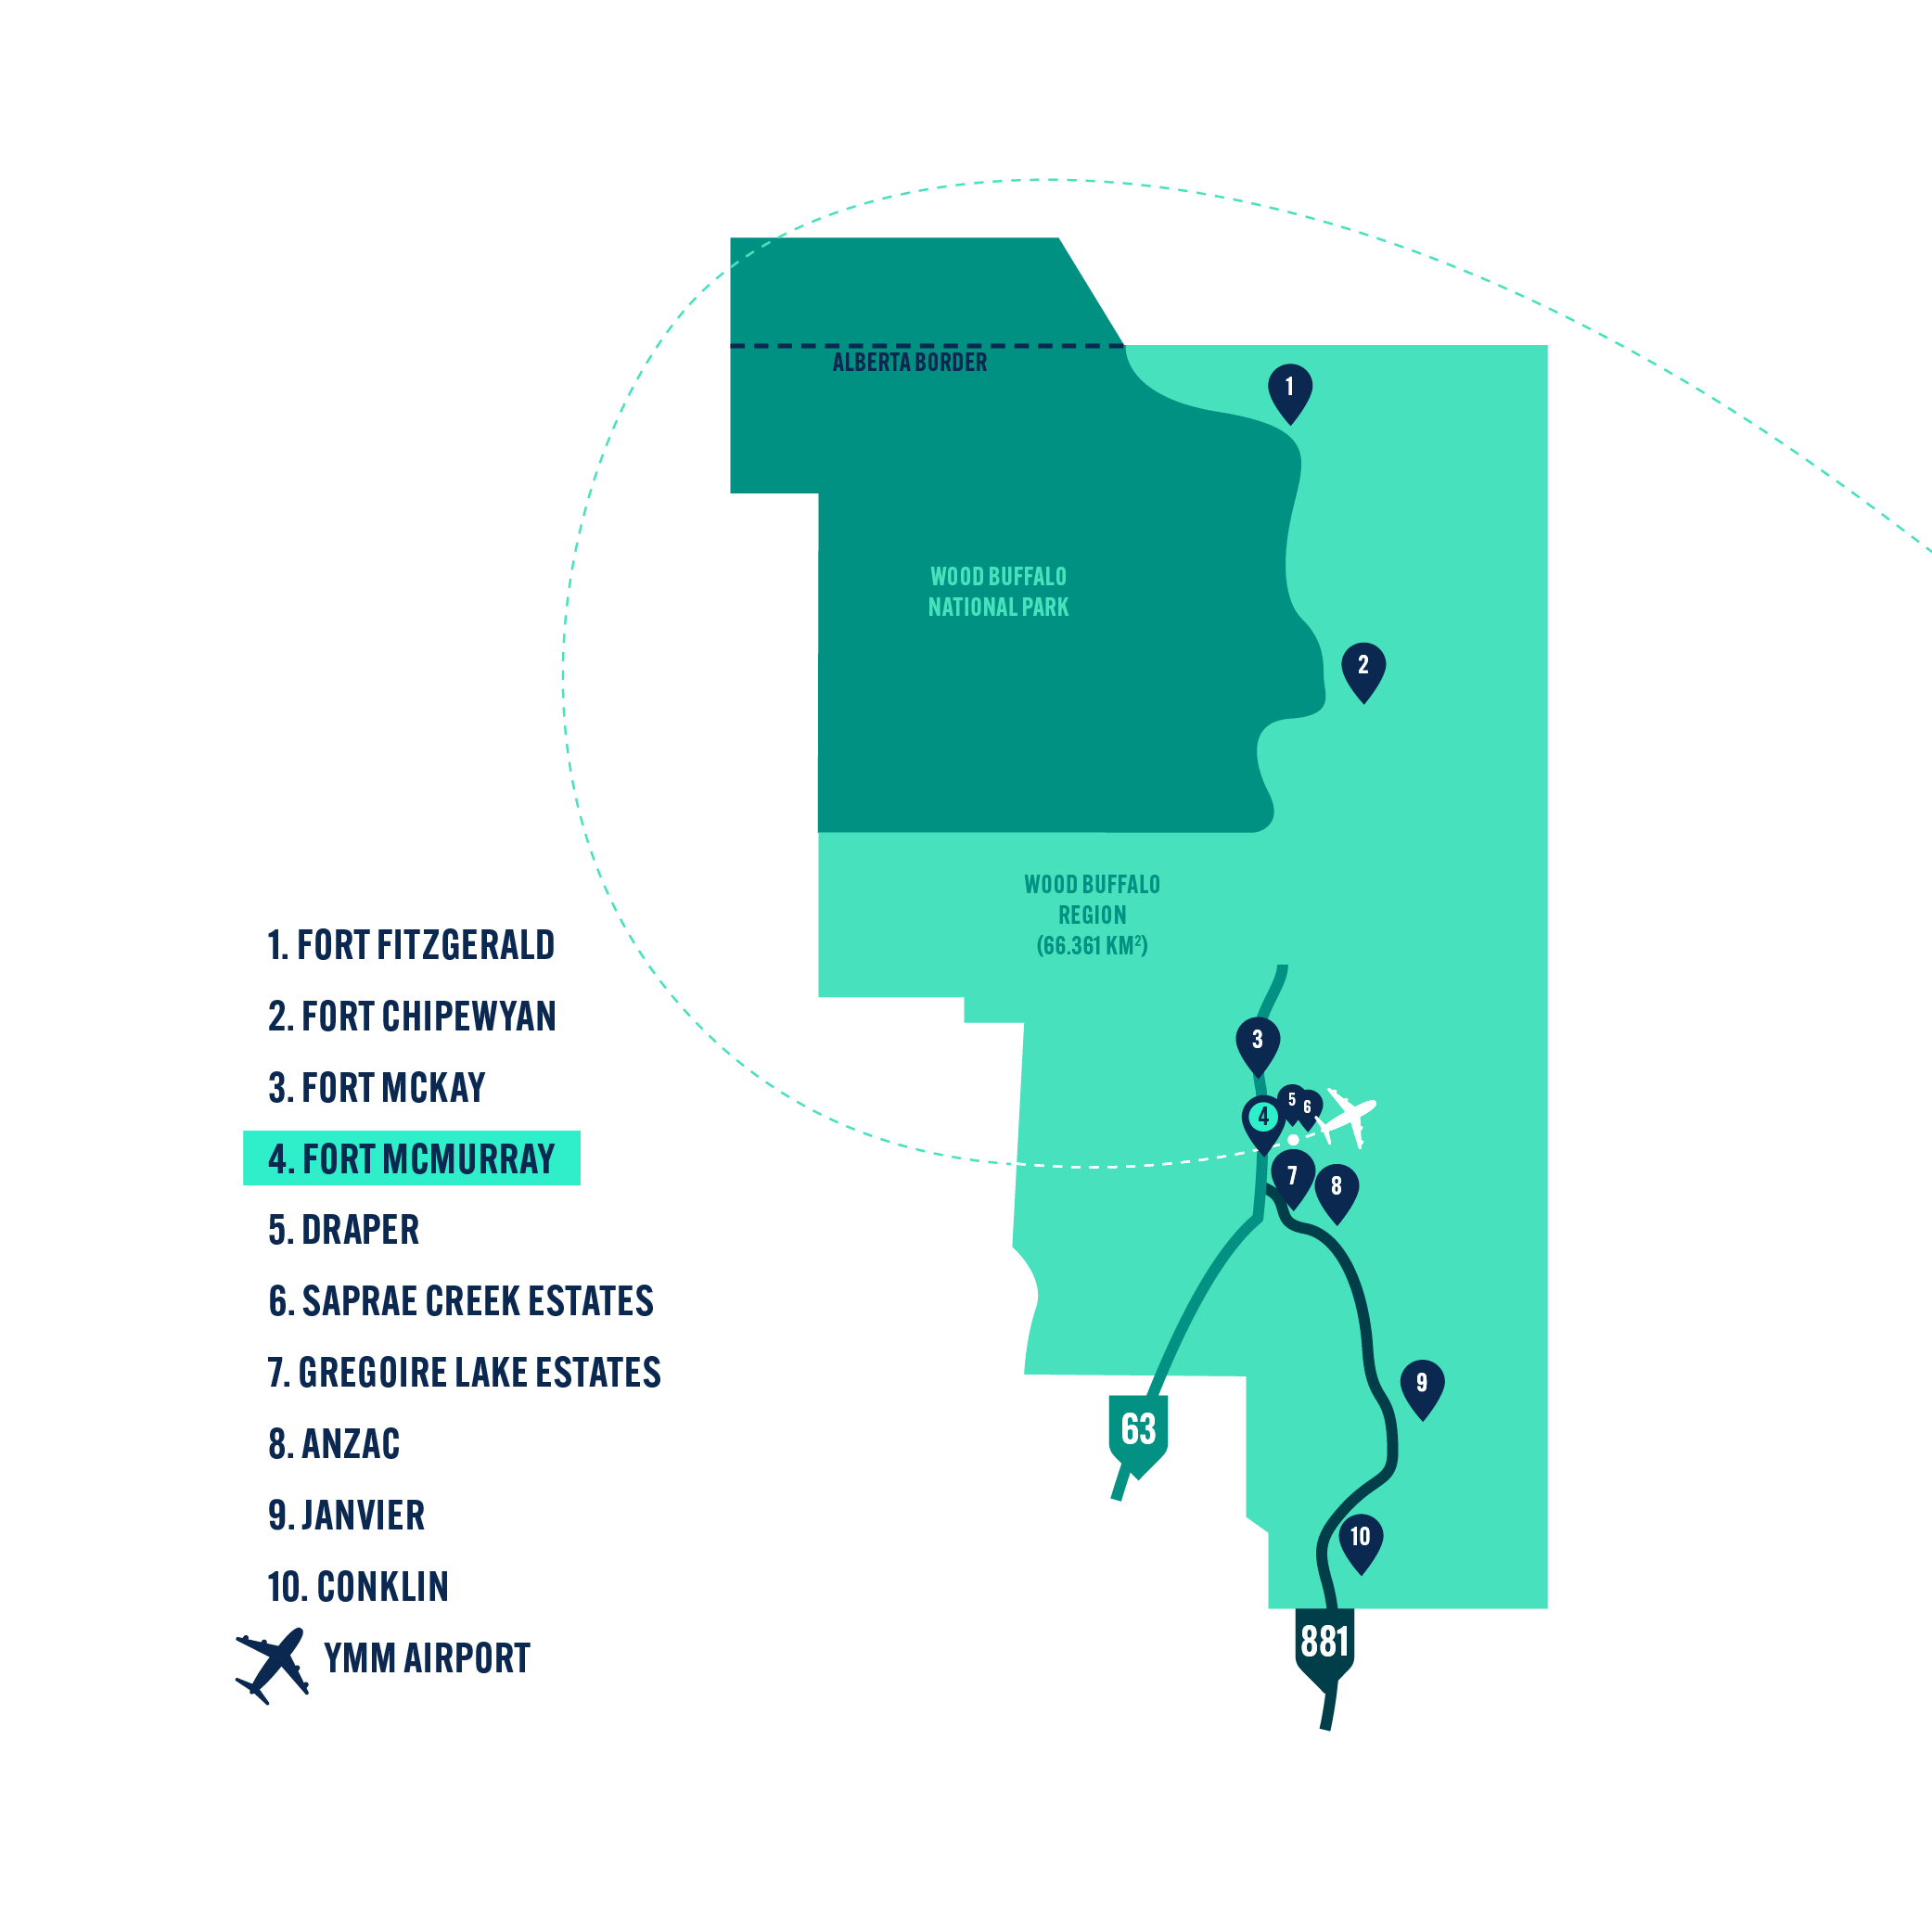
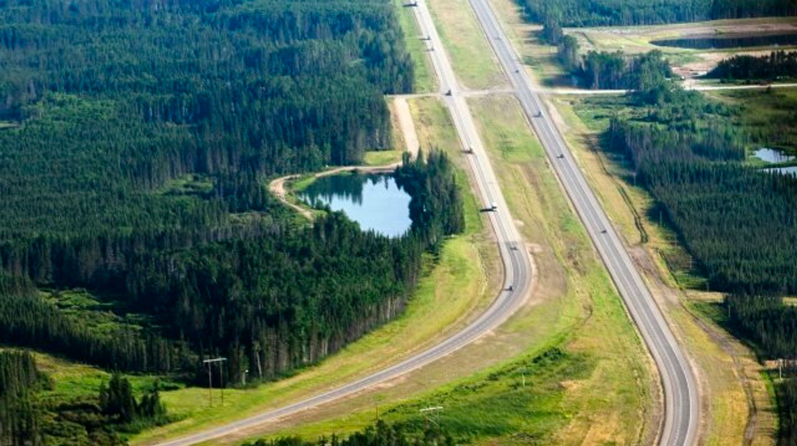
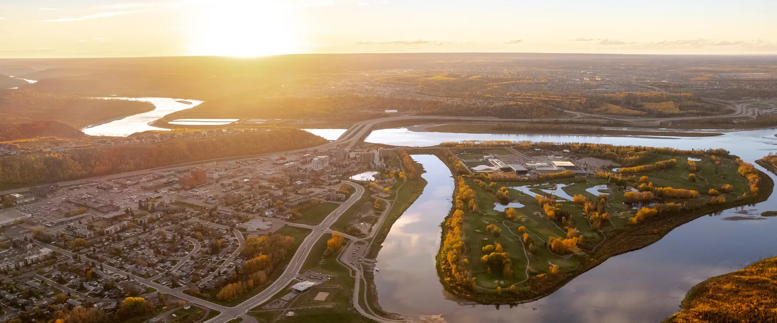
LOCATION AND TRAVEL
Airport
The scenic drive on AB twinned Hwy 63 or two lane paved Hwy 881 are both through agricultural land followed by the boreal forest is approximately 4 hour drive from Edmonton and 7 hours from Calgary
Divided Highway
City Centre

Slide 3

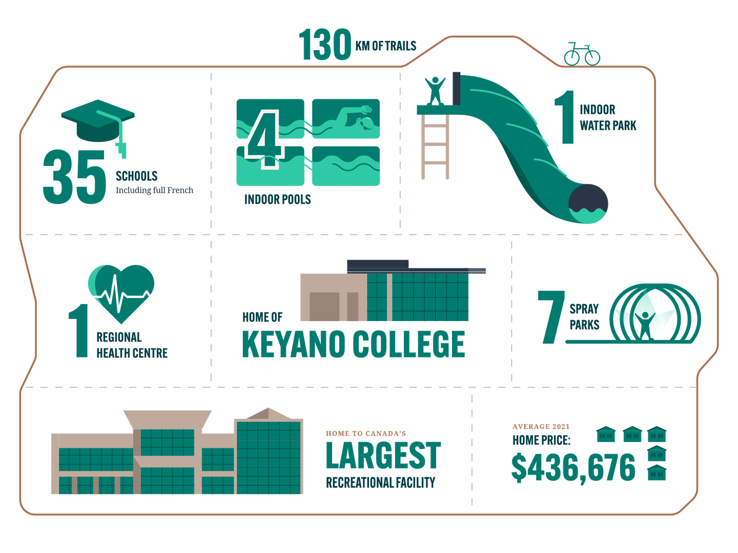
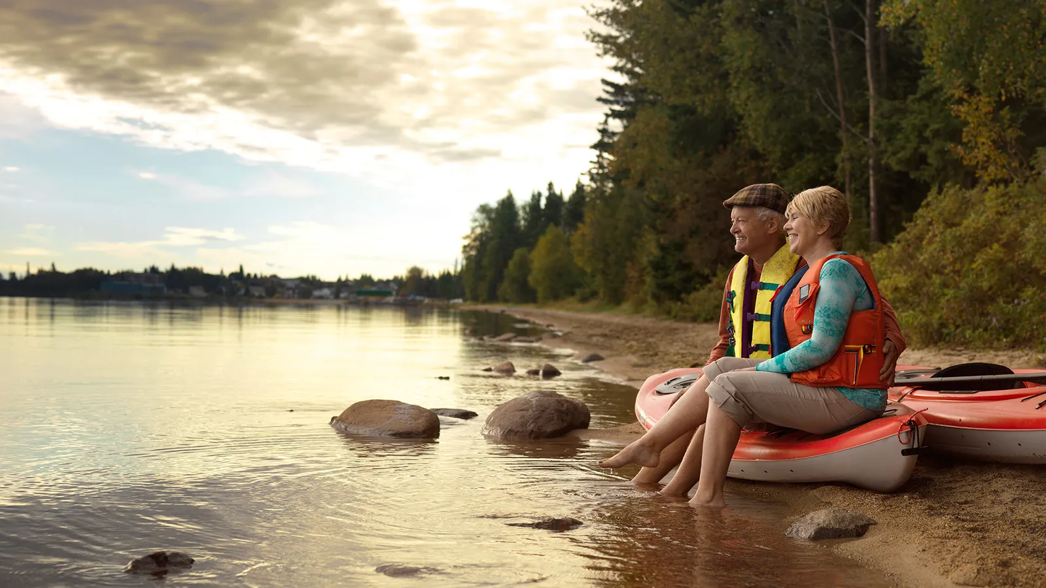
LIFESTYLE
The population of Fort McMurray is about 106,059(2021) and the quality of life that’s really worth mentioning. Our community is safe, diverse and affordable. We are home to a vibrant arts and cultural scene with an abundance of nature, space to move and room to thrive never ceases to amaze.

Slide 4
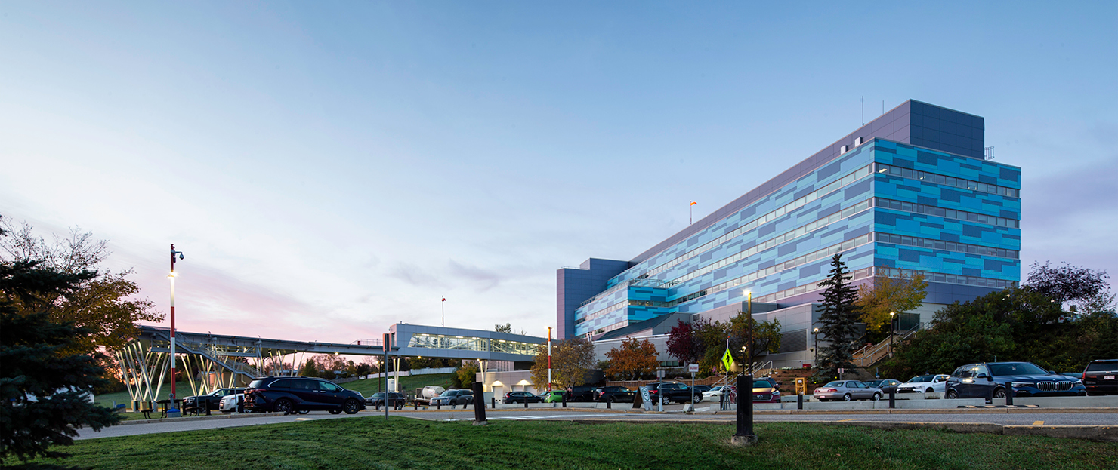
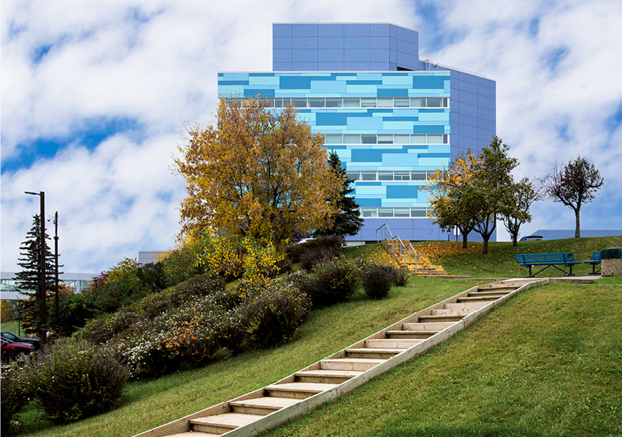
NORTHERN LIGHTS REGIONAL
HEALTH CENTRE
Specialties:
Internal Medicine
Ob/Gyn
Ophthalmology
Orthopedics, Trauma & Spine
Adult & Child Psychiatry, Addictions & Mental Health
Pediatrics
Emergency Department
Geriatric Medicine
Hospital Medicine
Critical Care Medicine
General Surgery
Urology
Radiology
Anesthesia
Palliative Care & Oncology
Long-Term Care
Outpatient Services:
Wound Clinic
Endoscopy/colposcopy
Minor Surgery
Infusion Clinic
Orthopedic Clinic
Emergency Department
Allied Health
APL
Satellite Oncology Clinic
(Collaboration with Cross Cancer
Institute)
Satellite Dialysis Clinic
(Collaboration with Alberta Renal
Program)
Diagnostic Imaging (X-Ray, CT,
Ultrasound, MRI, Mammography
and Fluoroscopy)

Slide 5
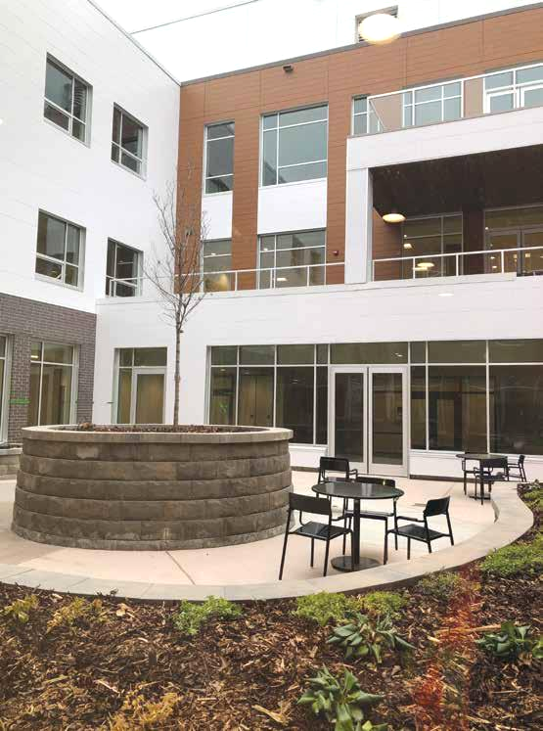
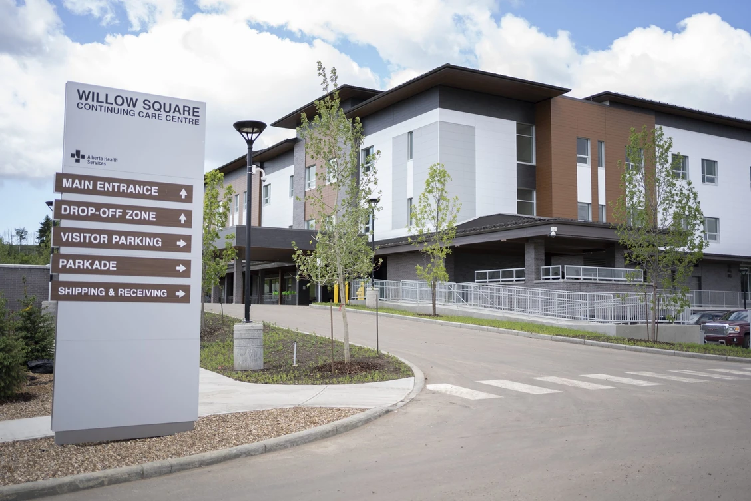
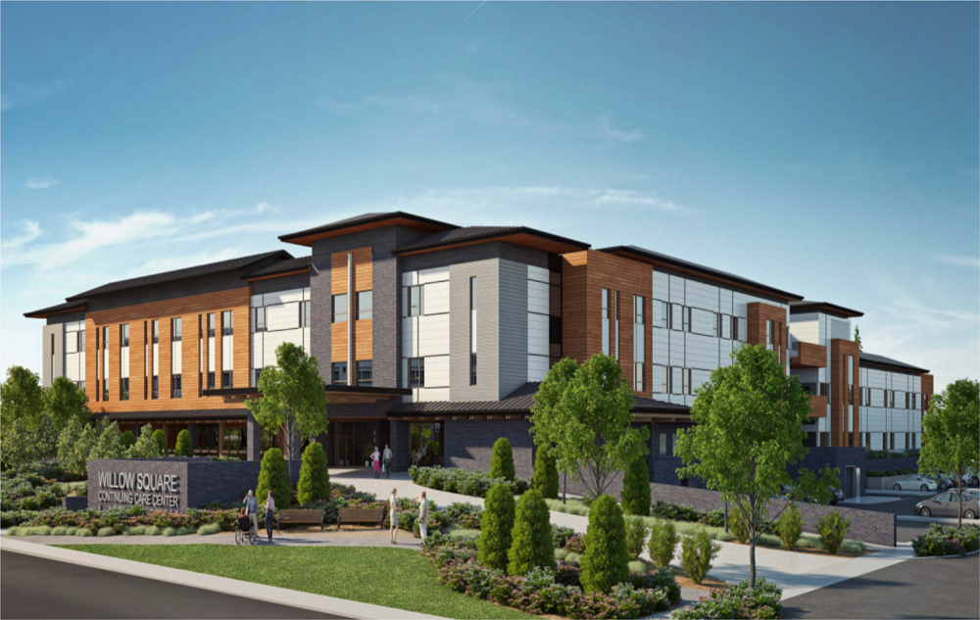
WILLOW SQUARE CONTINUING CARE
108 bed continuing care centre that operates as a campus model with support services extending from NLRHC
Three levels of care:
DSL 4D
Dementia Care
LTC

Slide 6
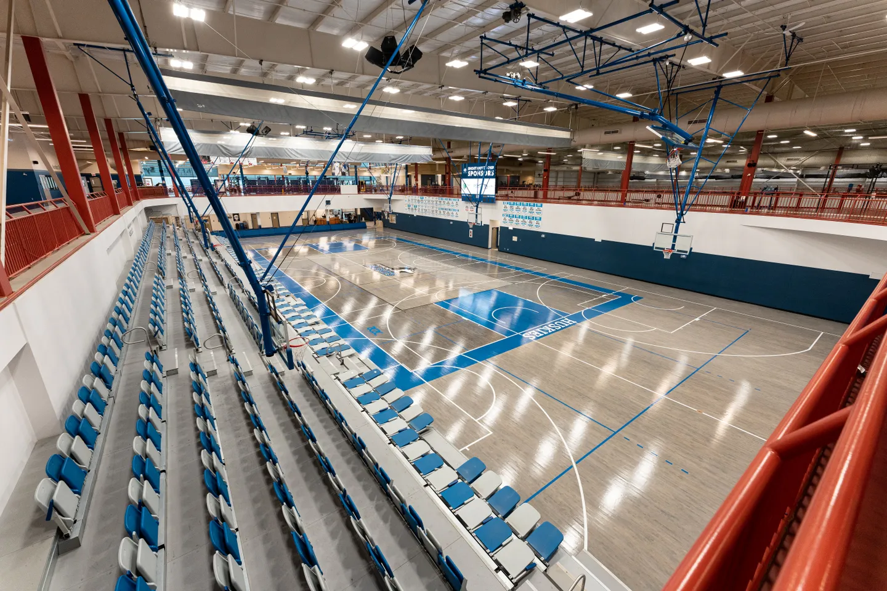
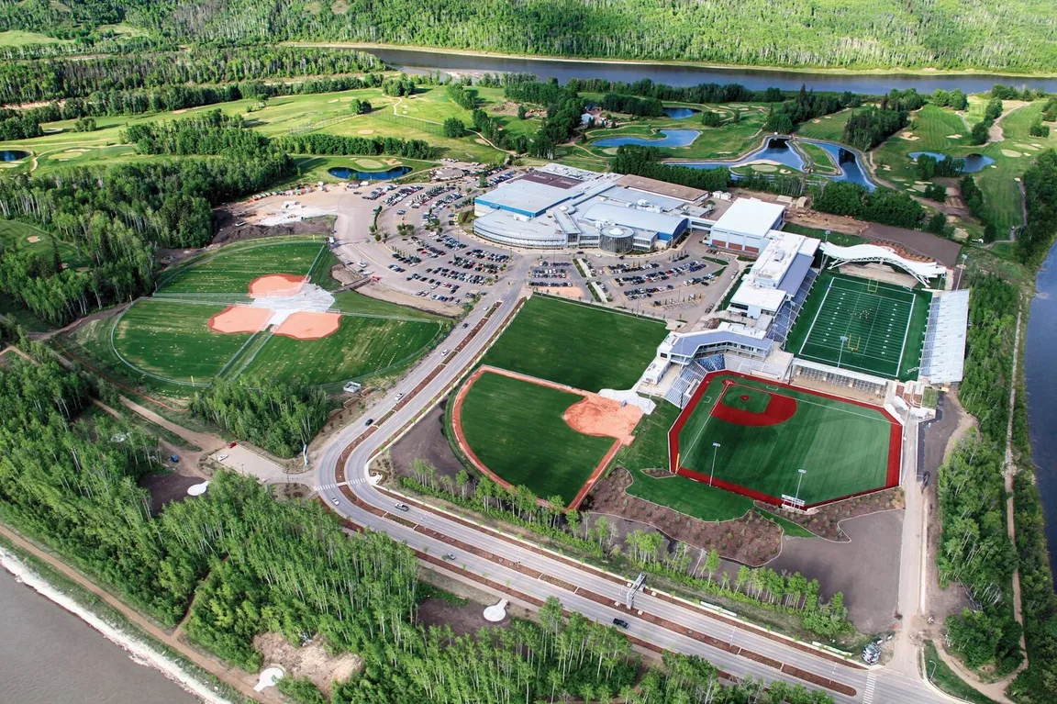
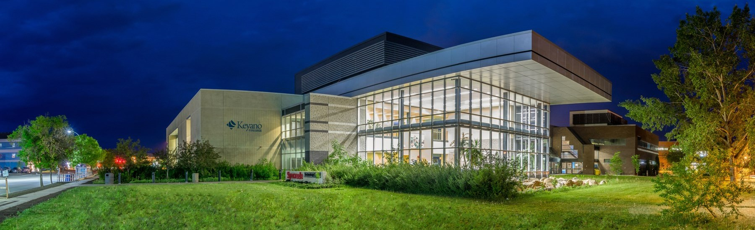
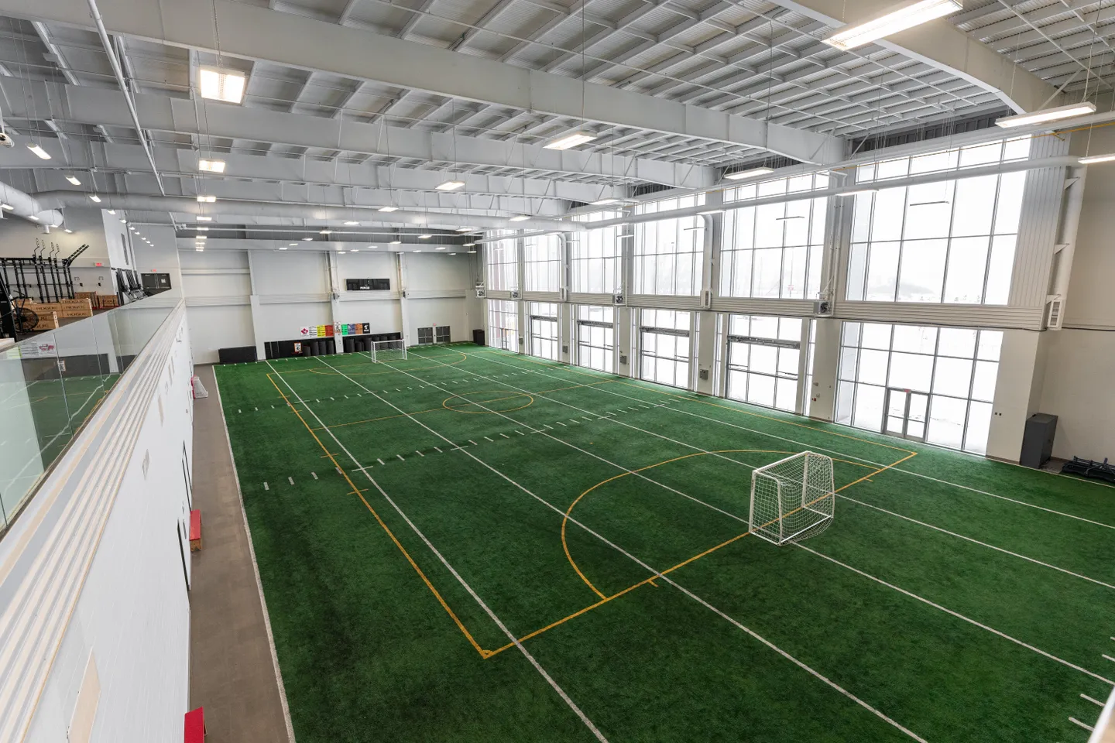
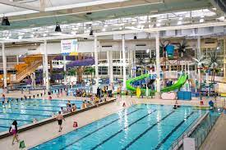
ACTIVITIES AND AMENITIES
KEYANO COLLEGE
MACDONALD ISLAND PARK

Slide 7
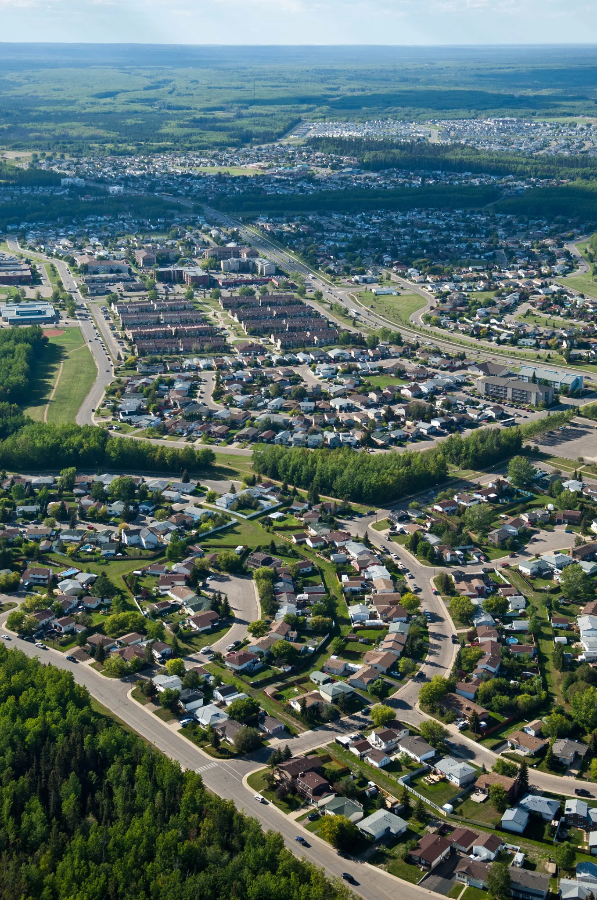
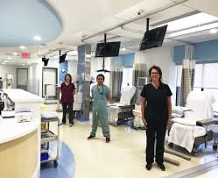



LIVE AND WORK
Discover Northern Alberta Incentives
The Northern Incentives Program is comprised of non-pensionable allowances tailored uniquely to employees whose work sites fall within specific geographic areas in Northern Alberta.
The allowances are separate and non-cumulative, and are provided to all employees, including those working with AHS on a temporary basis, as shown below.
NORTHERN ALLOWANCE - FTE $6300
REMOTE RETENTION ALLOWANCE - FTE $3000
FORT MCMURRAY ALLOWANCE - FTE $12,480
TRAVEL REIMBURSEMENT - 1 ROUND TRIP PER YEAR WITHIN ALBERTA
(https://www.albertahealthservices.ca/careers/Page12214.aspx)

Slide 8

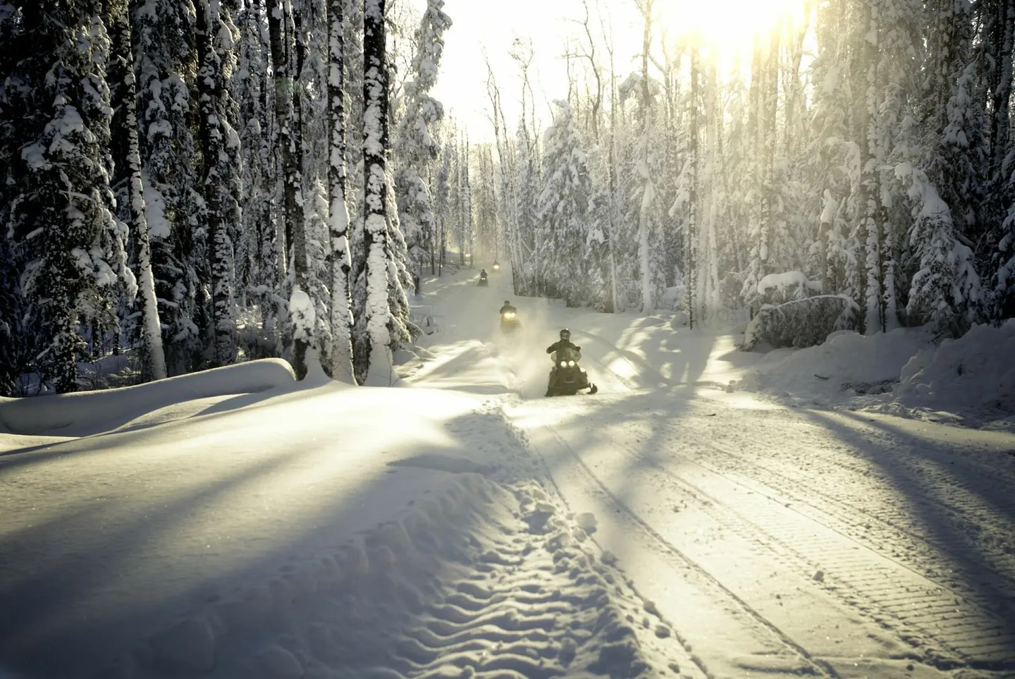
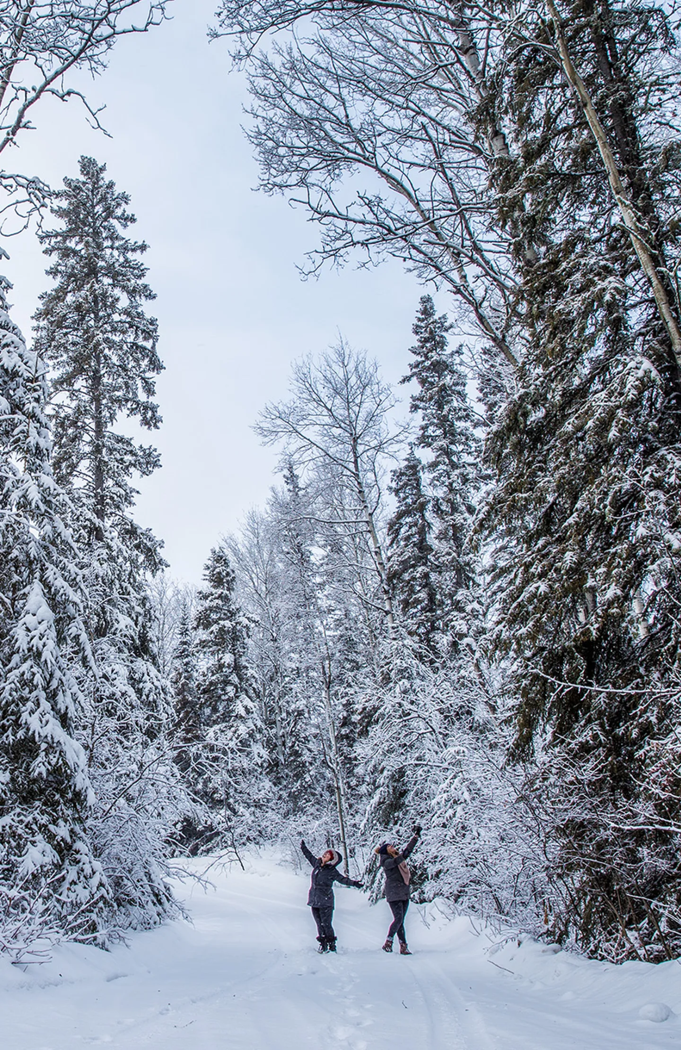
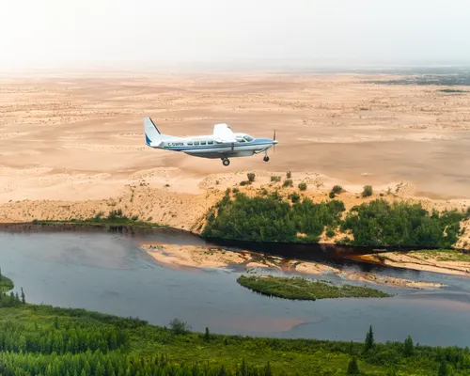
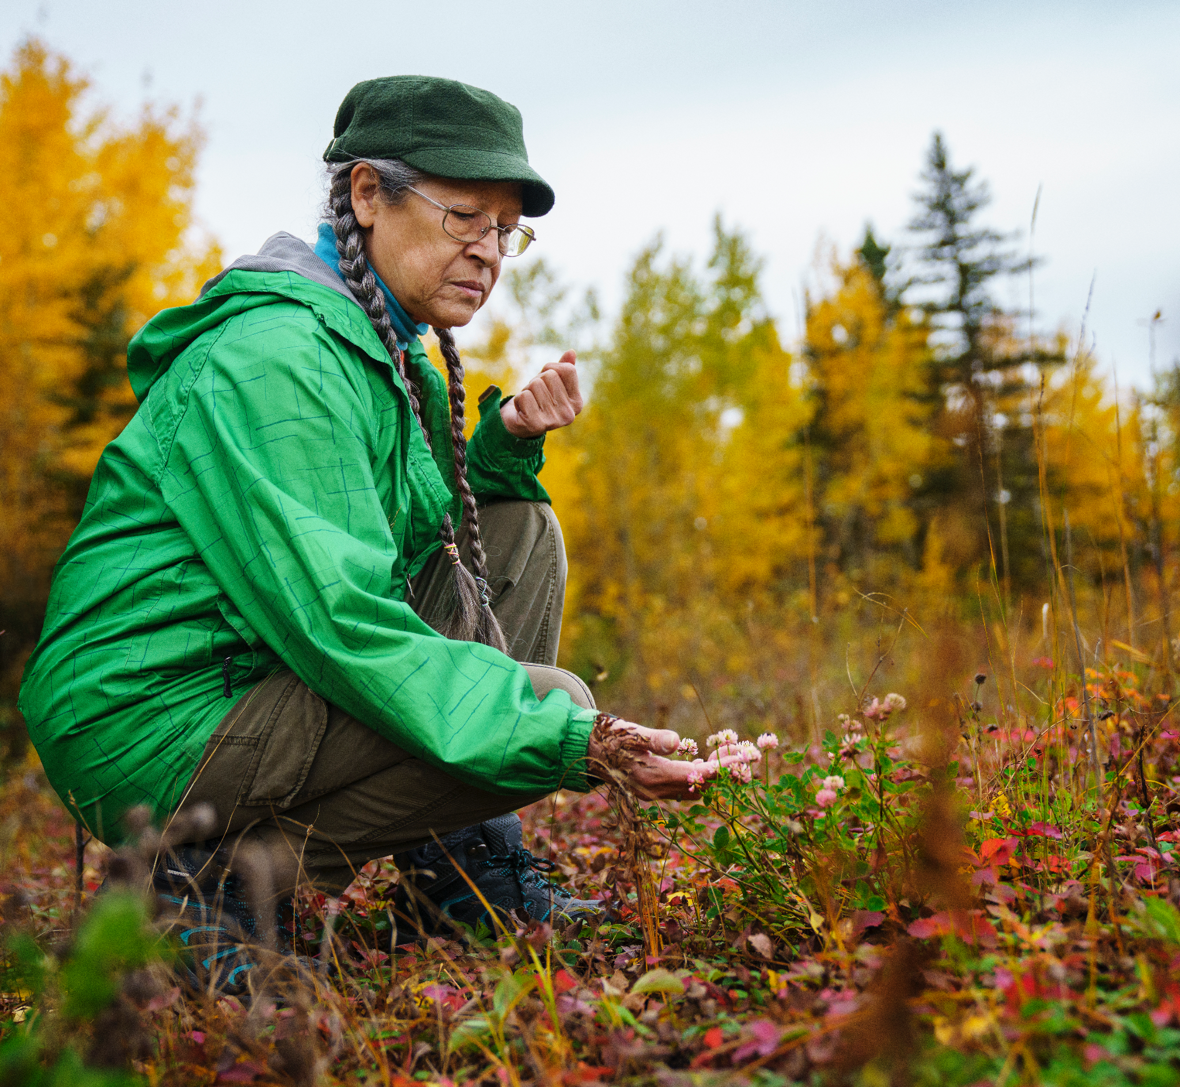
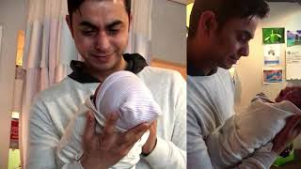
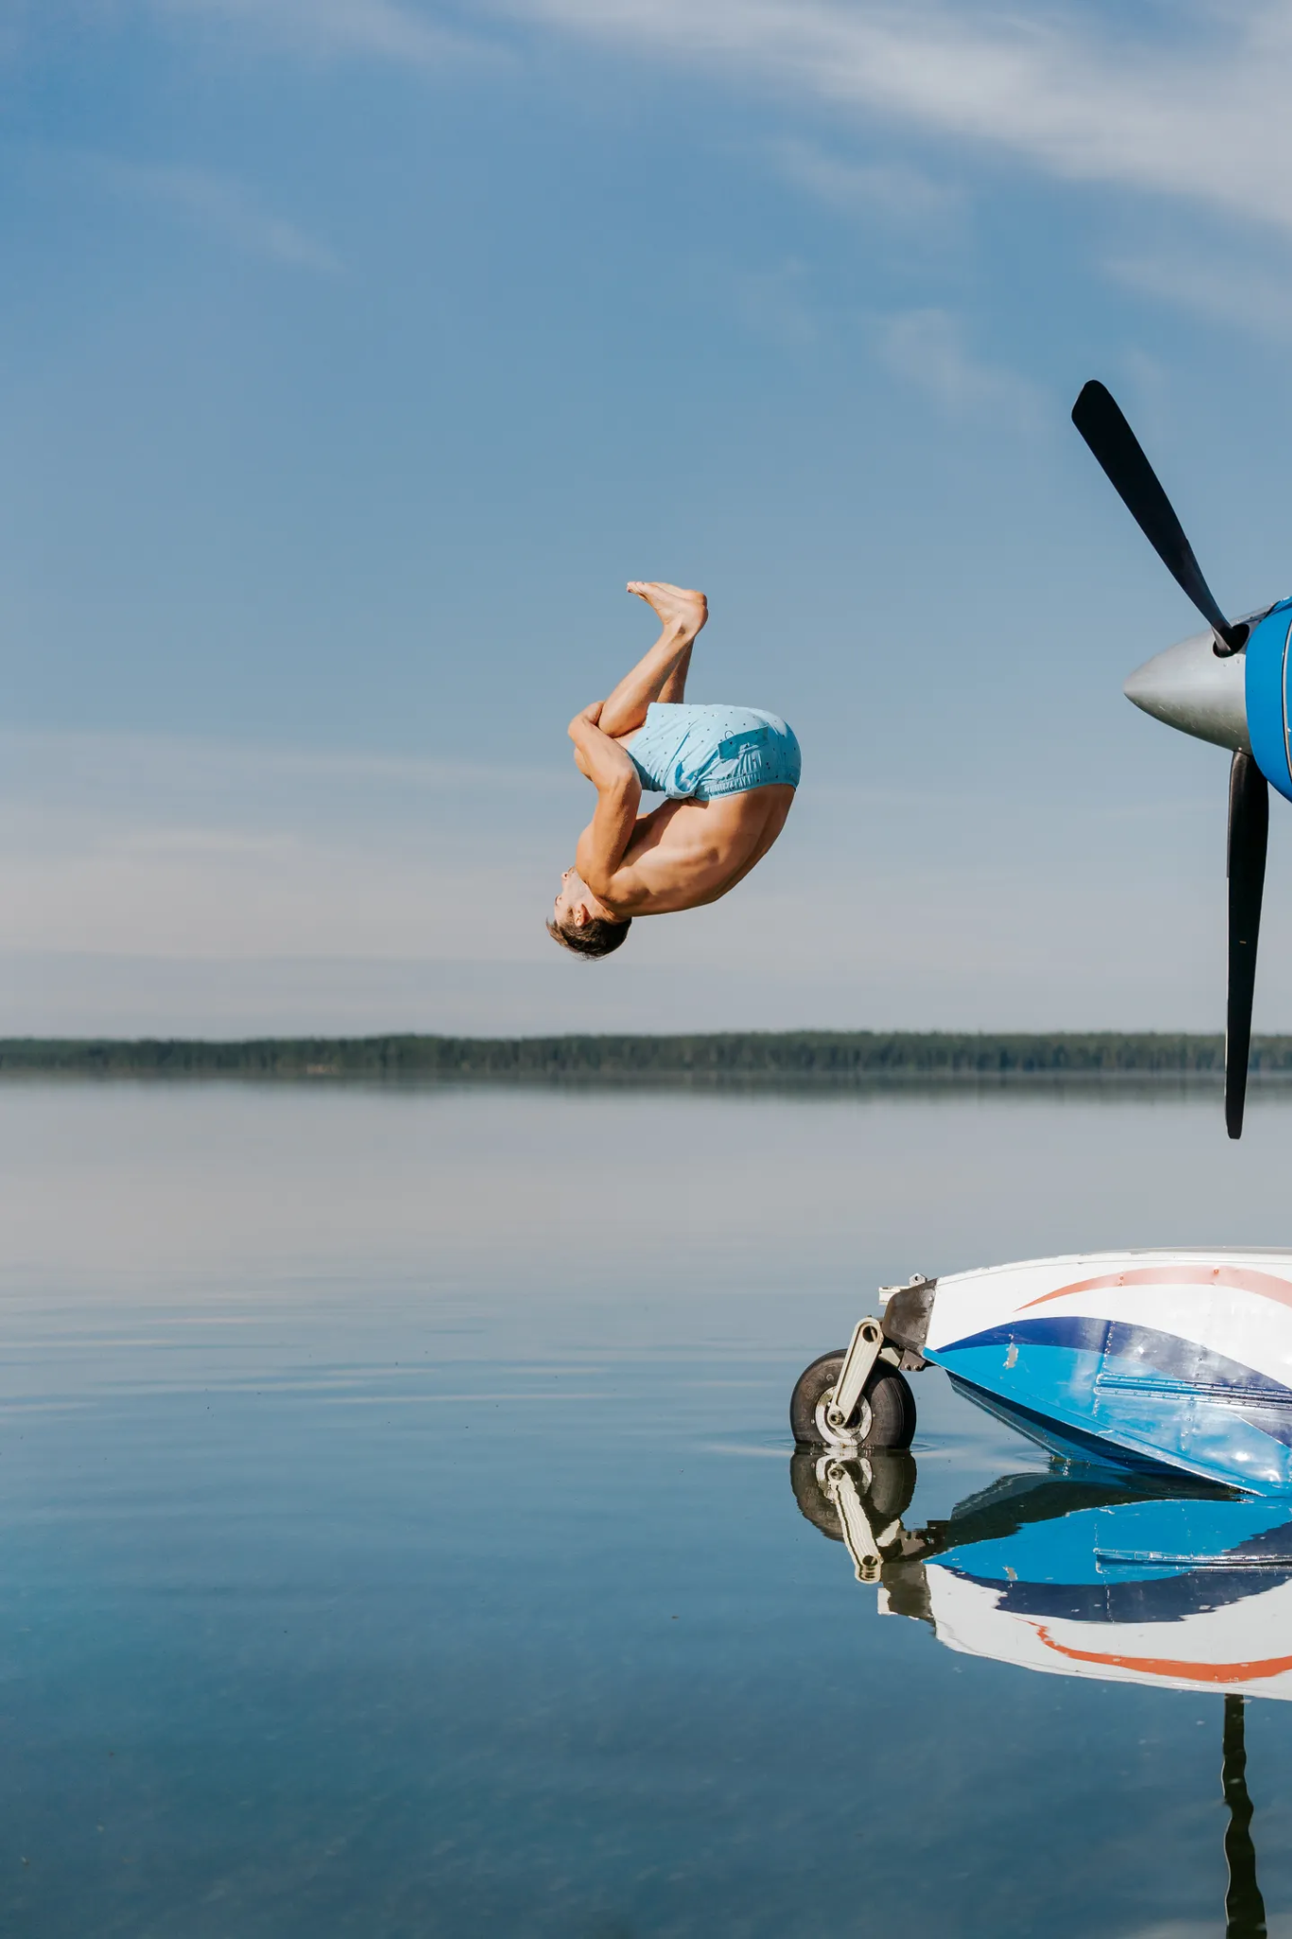
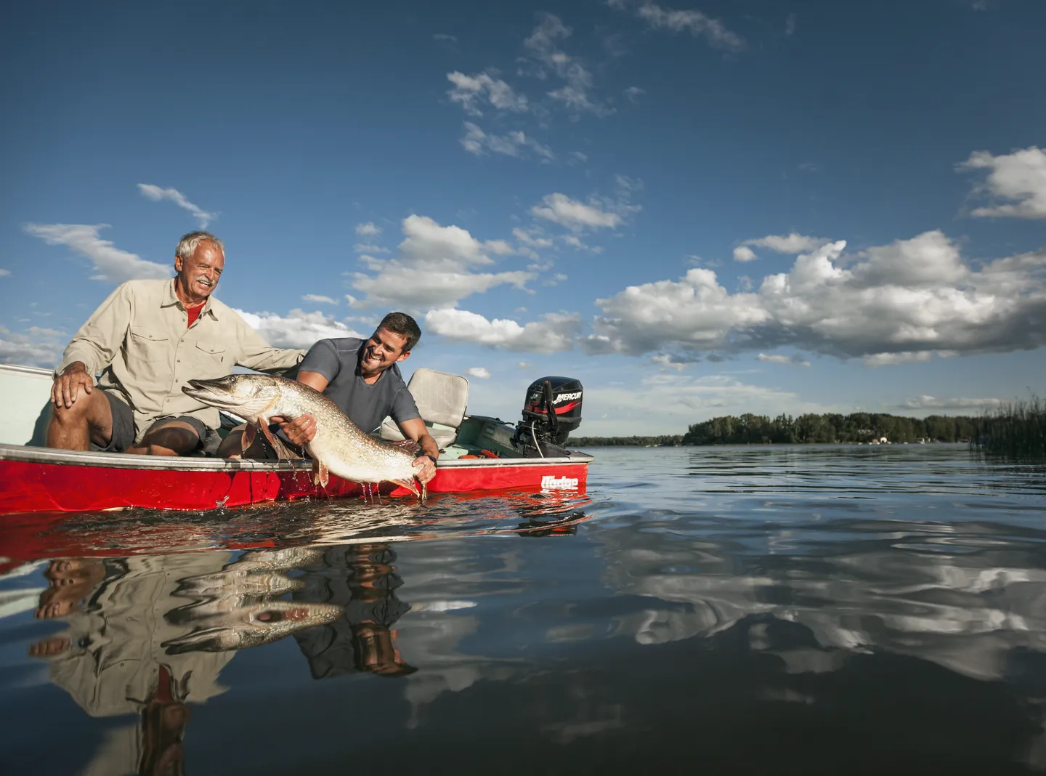
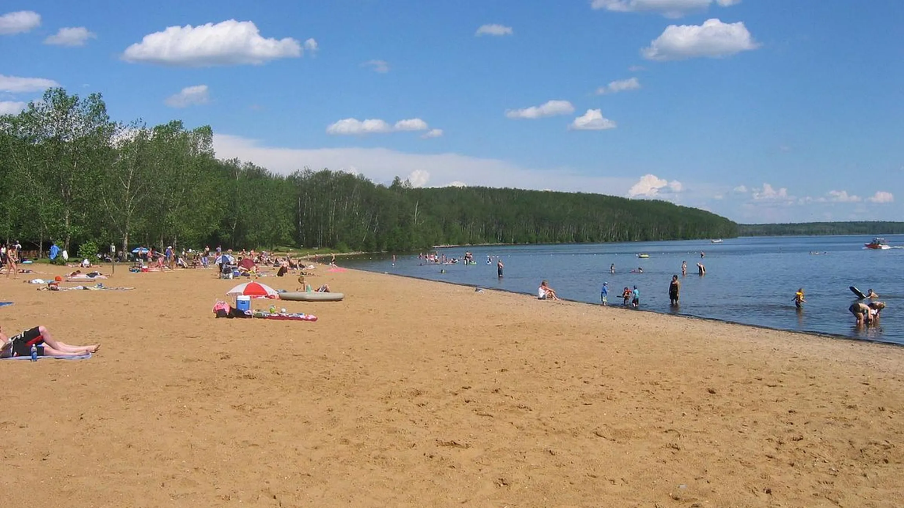
Join us and Enjoy the Lifestyle of the North!

