Slide 1

Alumni Weekend 2019
Class of 1999 Reunion

Slide 2
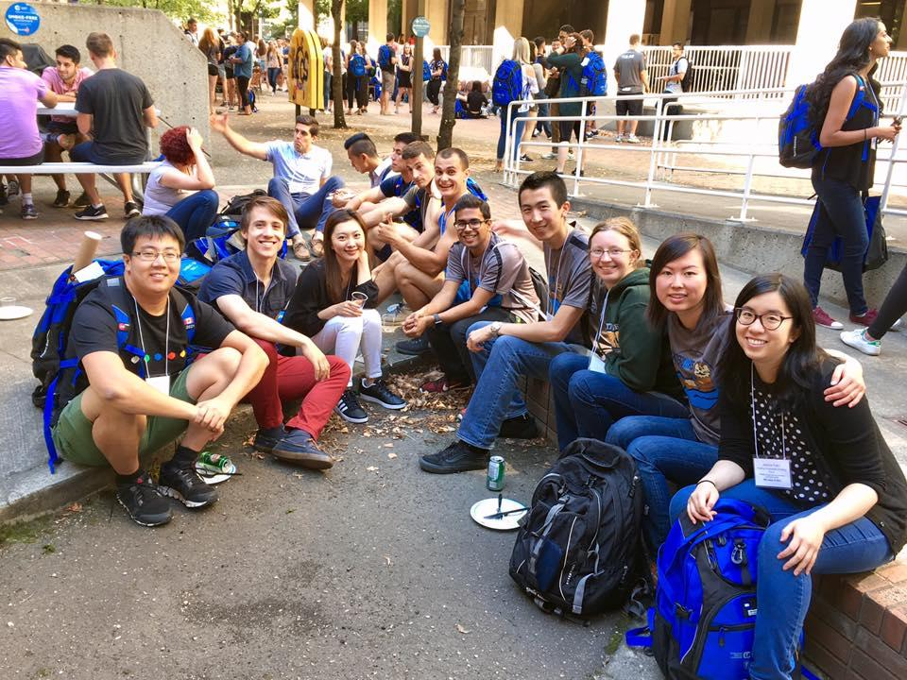
Caption

Slide 3
Class trip to …

